Slide 1
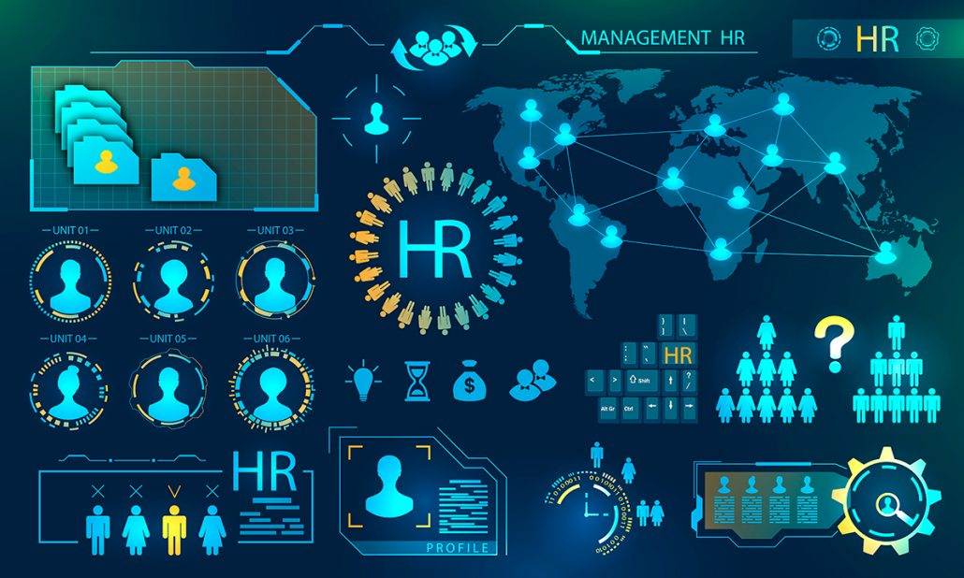
HR ANALYTICS PROJECT
Presented by – Group-2
Shreyas Reddy D
Shivam Shekhar
Sowparnika V
Parimala
Athira Anikumar Kaladevi
Ayyala Lahari
Ramjee Prasad

Slide 2
INDEX
Project Title and Teammates. 01
KPIs and Their Observations. 3-10
Excel Dashboard. 11-12
Tableau Dashboard. 13
MySQL Dashboard. 14-16
Power BI Dashboard. 17-18
Challenges and How They Were Overcome. 19
Conclusion. 20

Slide 3
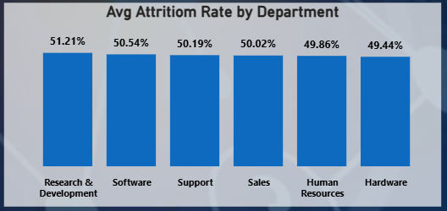
KPIs and Their Observations
Avg Attrition Rate by Department
The highest attrition is seen in Research & Development (51.21%), followed closely by Software and Support departments.
Human Resources (49.86%) and Hardware (49.44%) show comparatively lower attrition rates, indicating better retention in those areas.
1
2
3
4
5
6
7
8

Slide 4
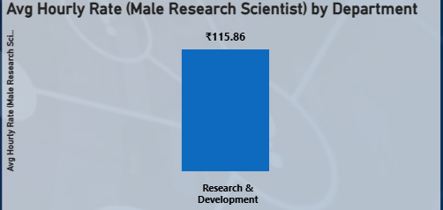
KPIs and Their Observations
Average hourly rate for Male Research Scientists
The average hourly rate for Male Research Scientists in the Research & Development department is ₹115.86.
This indicates a consistent compensation level for this role within the department.
1
2
3
4
5
6
7
8

Slide 5
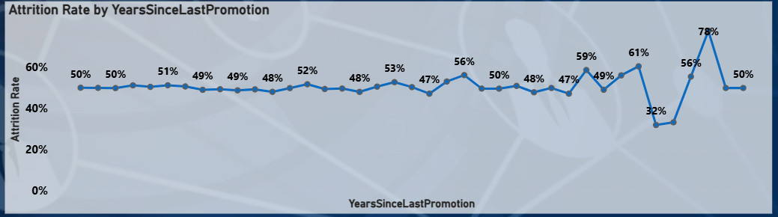
KPIs and Their Observations
Attrition rate Vs Year since last promotion relation
The attrition rate remains fairly steady between 47% and 56% for most employees, regardless of years since last promotion.
However, a sharp spike to 78% indicates significantly higher attrition among employees who haven’t been promoted for many years.
1
2
3
4
5
6
7
8

Slide 6
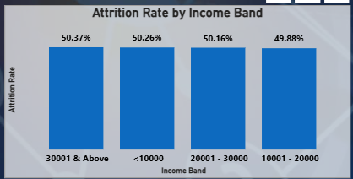
KPIs and Their Observations
Attrition Rate by Income Band
Attrition rates are nearly identical across all income bands, ranging from 49.88% to 50.37%.
This shows that income level has little effect on employee turnover.
1
2
3
4
5
6
7
8

Slide 7
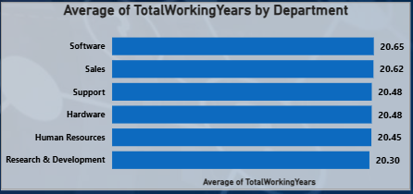
KPIs and Their Observations
Average of Total Working Years by Department
Employees across all departments have similar total working experience, averaging around 20 years.
The Software department shows the highest average (20.65 years), while R&D has the lowest (20.30 years).
1
2
3
4
5
6
7
8

Slide 8
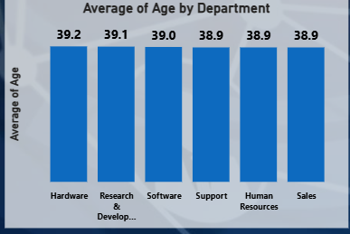
KPIs and Their Observations
Average of Age by Department
The average employee age is consistent across departments, ranging from 38.9 to 39.2 years.
Hardware employees have the highest average age (39.2), while Support, HR, and Sales share the lowest (38.9).
1
2
3
4
5
6
7
8

Slide 9
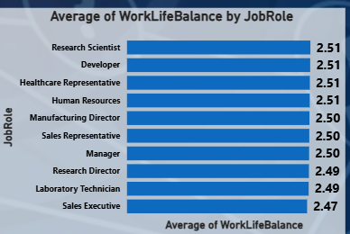
KPIs and Their Observations
Average Work-Life Balance by Job Role
The average work-life balance across job roles ranges narrowly between 2.47 and 2.51, indicating consistent perceptions of work-life balance among employees
Research Scientists, Developers, Healthcare Representatives, and HR professionals report the highest average score (2.51).
Sales Executives have the lowest average (2.47), suggesting slightly lower satisfaction with work-life balance compared to other roles.
1
2
3
4
5
6
7
8

Slide 10
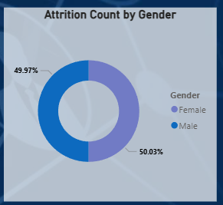
KPIs and Their Observations
Attrition Count by Gender
Attrition is almost equally distributed between males (50.03%) and females (49.97%), with only a 0.06% difference.
This indicates that gender has minimal impact on employee turnover within the organization.
1
2
3
4
5
6
7
8

Slide 11





Excel
MySQL
Tableau
PowerBI

Slide 12
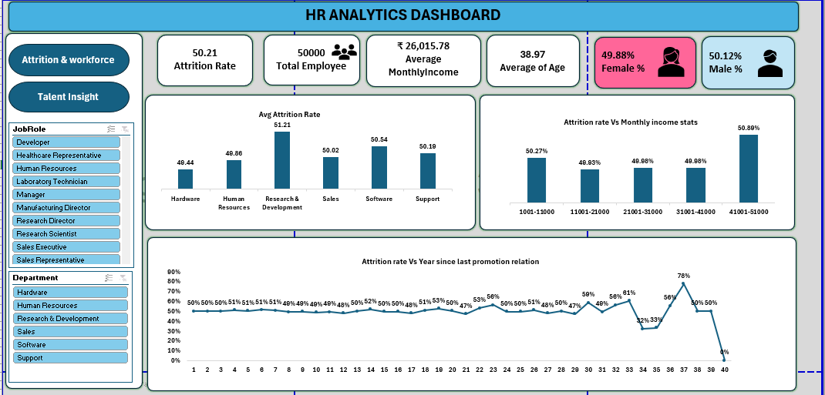
Excel
MySQL
Tableau
PowerBI

Slide 13
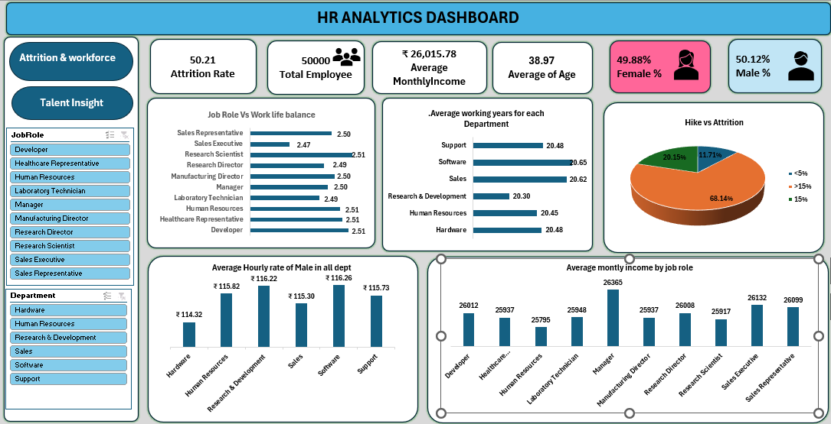
Excel
MySQL
Tableau
PowerBI

Slide 14
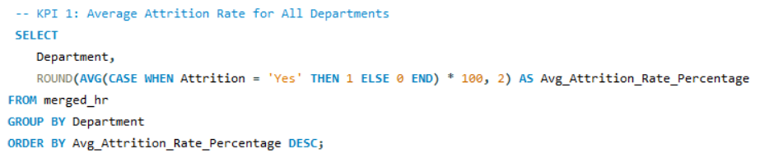
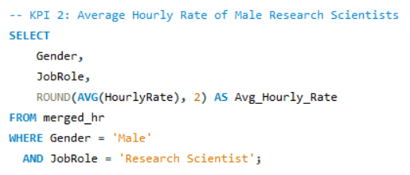
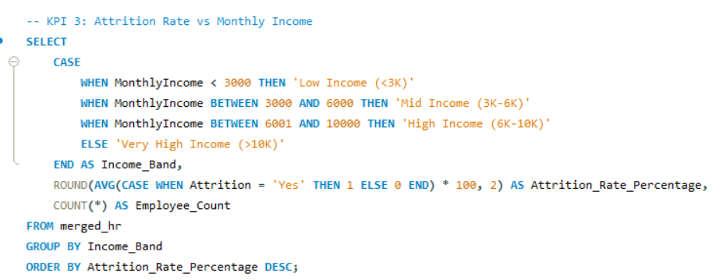
Excel
MySQL
Tableau
PowerBI

Slide 15
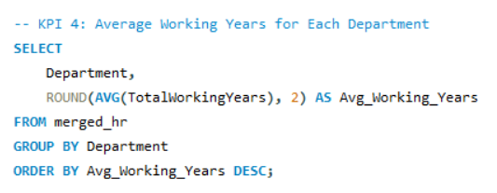
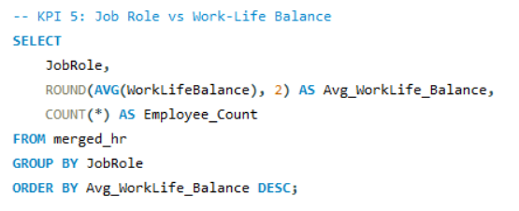
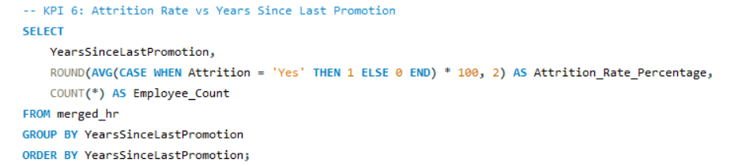
Excel
MySQL
Tableau
PowerBI

Slide 16
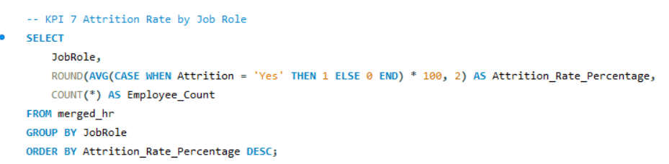
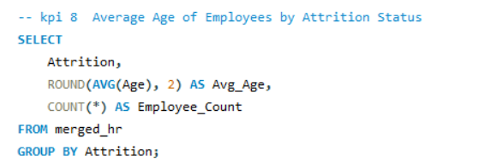
Excel
MySQL
Tableau
PowerBI

Slide 17
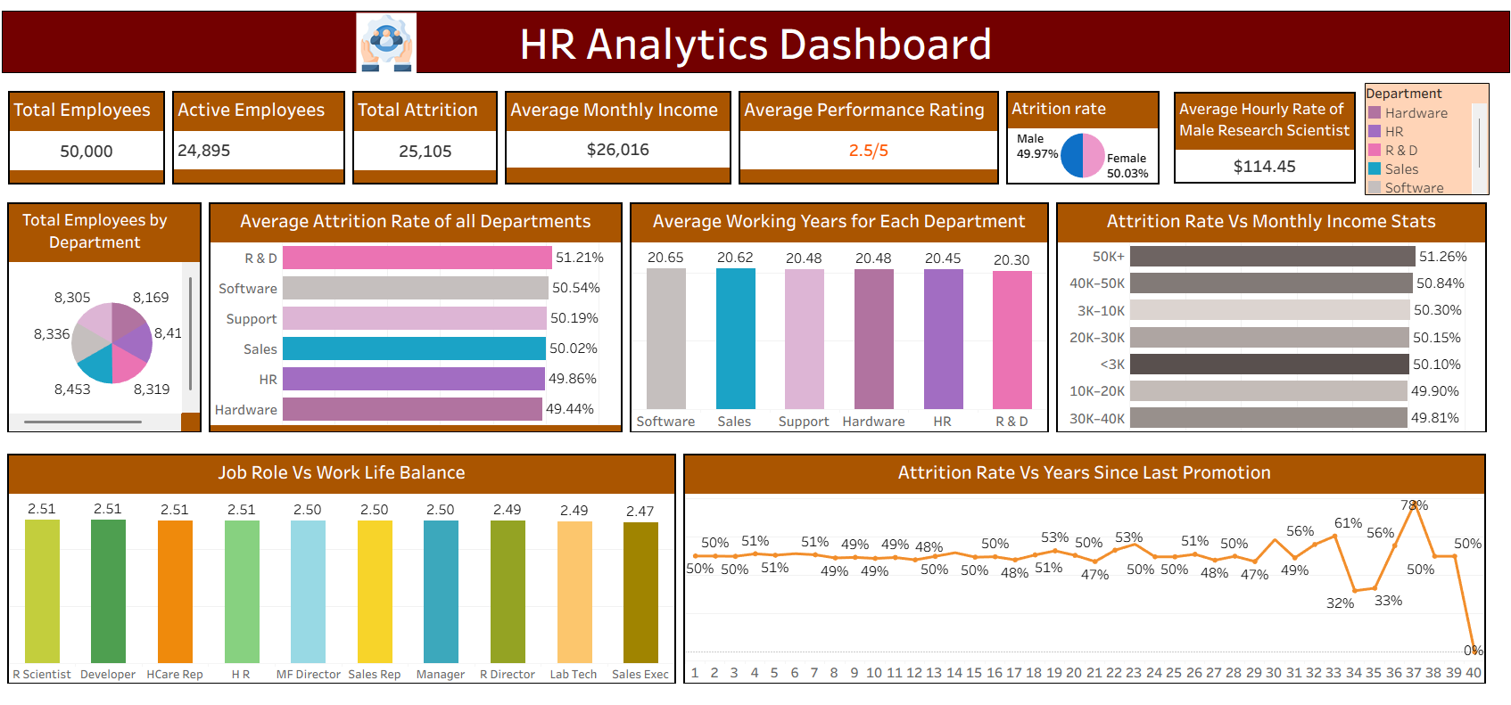
Excel
MySQL
Tableau
PowerBI

Slide 18
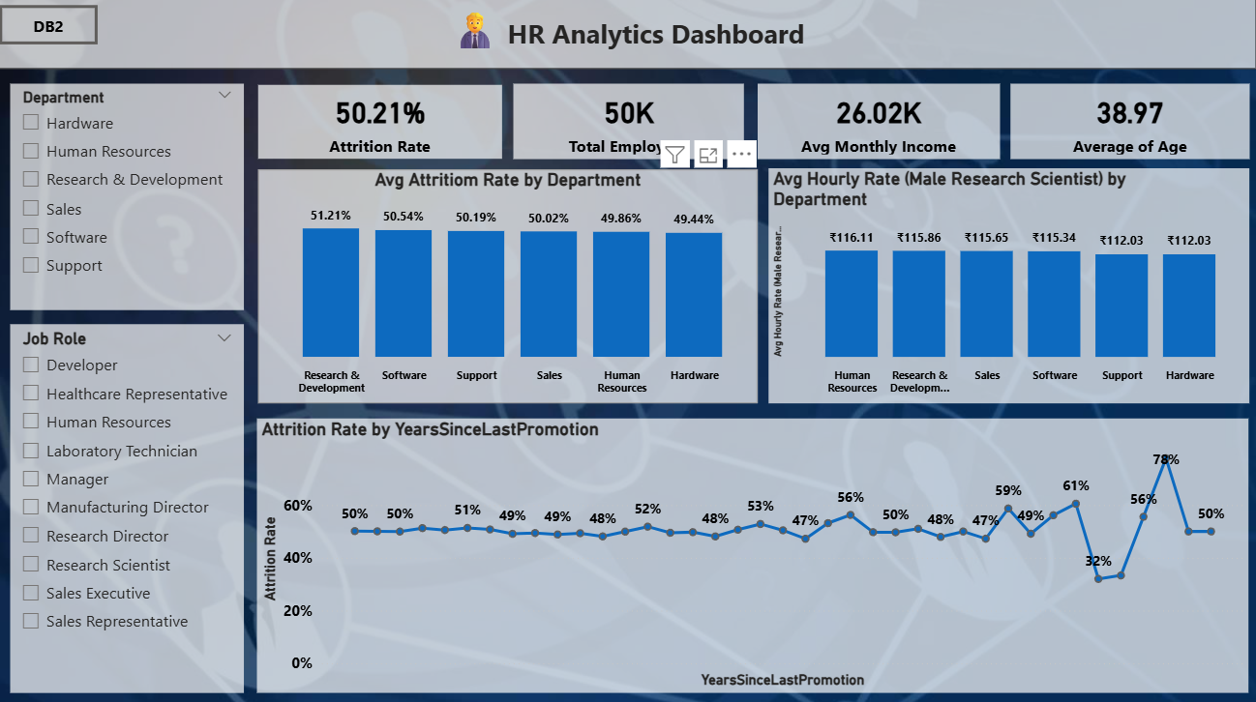
Excel
MySQL
Tableau
PowerBI

Slide 19
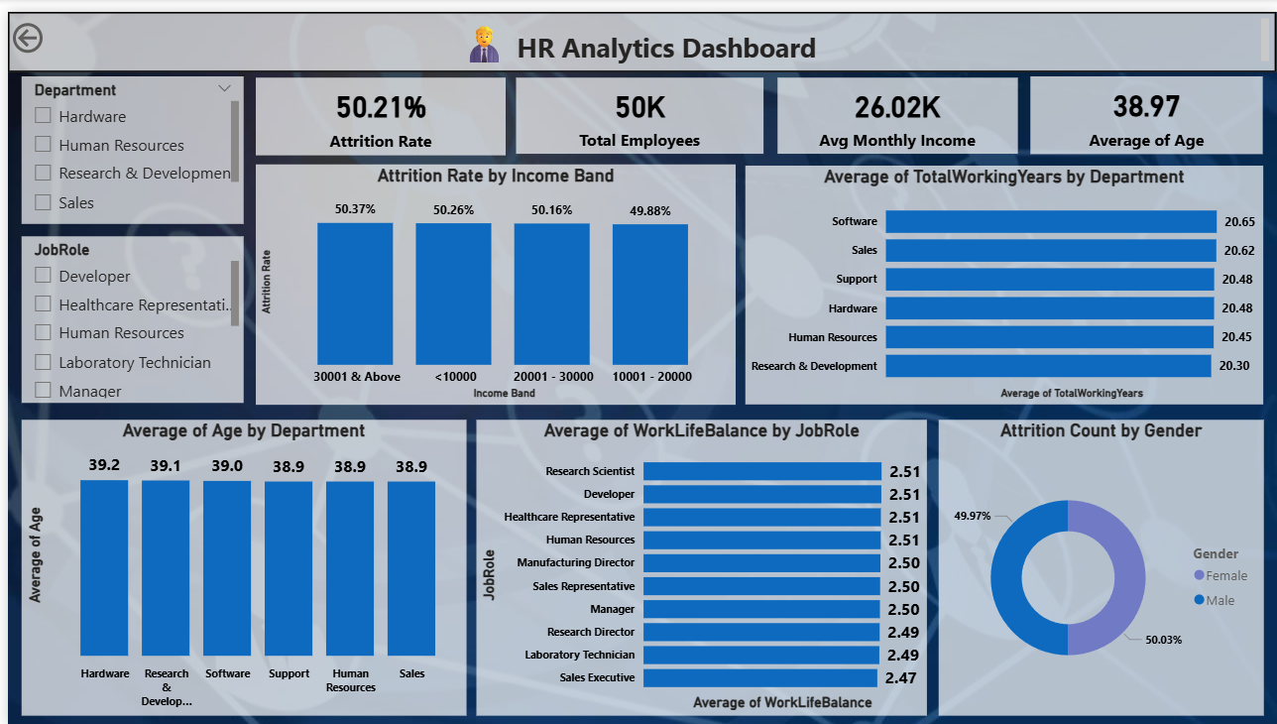
Excel
MySQL
Tableau
PowerBI

Slide 20
Challenges and How They Were Overcome
Challenges:
Integrating data from multiple sources (Excel, MySQL) while maintaining accuracy.
Handling data inconsistencies, missing values, and duplicate records in HR datasets.
Designing interactive dashboards in Tableau and Power BI with clear KPIs.
Ensuring real-time insights and smooth performance in visual tools.
Difficulty in identifying key attrition drivers among numerous HR variables.
How They Were Overcome:
Used MySQL to clean, merge, and structure datasets efficiently using SQL joins and queries.
Applied data validation and cleaning techniques in Excel before visualization.
Created optimized data models in Power BI and Tableau for faster processing.
Used calculated fields and parameters to build dynamic dashboards.
Focused analysis on specific KPIs such as attrition rate, work-life balance, and income to draw actionable insights.

Slide 21
Conclusion
The HR Analytics project successfully provided data-driven insights into employee attrition, job satisfaction, and work-life balance.
Attrition was influenced by factors such as income level, promotion gap, and work-life balance.
Analysis revealed that both genders experience similar attrition rates, indicating fair workforce policies.
Tools like Power BI and Tableau enabled clear, interactive visualization of HR KPIs.
The project demonstrates how data analytics can support HR decision-making, helping reduce attrition and improve employee engagement

Slide 22
Conclusion
Impovement Strategies
Avg Attrition rate is 50% so the management need to focus on the employee retention strategy.
Average Performance Rating: Only 2.5/5 → indicates disengaged employees or ineffective performance management system, organization needs to focus on Quarterly and yearly progress.
Attrition increases sharply after 5–6 years since last promotion, peaking at 78% around 33 years.Lack of career advancement and delayed promotions directly fuel attrition. Employee engagements strategy should be made with HR heads.

Slide 23
THANK YOU

